Slide 1

Comprehensive Dashboard for Quick Commerce Performance and Customer Behavioral Insights
Integrated Analytical Solution Leveraging Excel, Python, SQL, and Power BI
A Capstone Project by - Prathamesh Iswalkar, utilizing advanced data analytics methodologies and tools, including Python for data processing, MySQL for robust database management, and Power BI for interactive visualization and reporting.

Slide 2
Acknowledgement
I would like to express my sincere gratitude to my mentors, instructors, and learning platforms for providing the knowledge and guidance required to complete this project successfully.
This capstone project is the result of self-learning, structured research, and hands-on implementation using industry-standard tools such as Python, SQL, and Power BI.
I would also like to acknowledge the data analytics community and official documentation resources that helped strengthen my understanding of advanced SQL concepts, data modeling, and dashboard design principles.
This project reflects the practical application of theoretical concepts into a real-world analytical workflow.

Slide 3
Project Overview
Project Objective
Scope of Work
Anticipated Outcome
To establish a comprehensive analytical pipeline, transforming raw data into actionable business intelligence.
Synthetic data generation and curation
Development of SQL-based Key Performance Indicator (KPI) models
Construction of a multi-page Power BI dashboard for visualization
Implementation of drill-through functionalities and performance optimization analysis
A simulated production-grade analytical workflow, demonstrating end-to-end data processing and insight generation.

Slide 4
Objective & Motivation
Project Objectives
Underlying Motivation
To precisely monitor key performance indicators (KPIs) spanning core business operations, customer interactions, and financial transactions.
To engineer robust and scalable analytical views underpinned by SQL, facilitating efficient data querying and analysis.
To furnish strategic business insights that are directly actionable, informing decision-making processes.
To transcend the limitations of conventional, small-scale academic datasets, fostering a more comprehensive understanding of data ecosystems.
To meticulously simulate the intricacies and vastness characteristic of real-world data environments.
To cultivate and refine analytics competencies that are immediately applicable and highly valued within professional industry contexts.

Slide 5
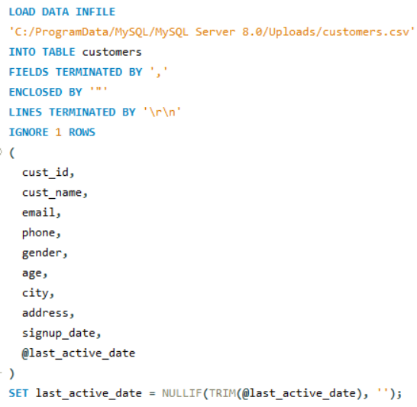
SQL Data Engineering & Ingestion
Purpose
This step establishes the foundation of the analytical system by configuring the SQL environment and ingesting high-volume transactional data efficiently.
What Was Implemented
Enabled bulk loading using LOCAL_INFILE
Created structured relational tables using InnoDB
Loaded large CSV datasets using LOAD DATA INFILE
Handled NULL values and boolean transformations during ingestion
Ensured correct data types for date-time and numeric fields
Why It Matters
Ensures scalability and performance
Mimics real-world production database setup
Prevents data inconsistencies before analysis begins

Slide 6
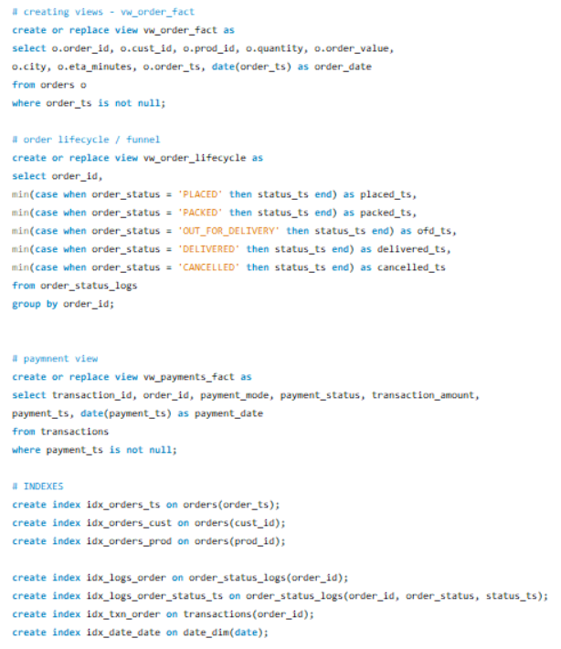
Analytical View Architecture (Semantic Layer)
Purpose
To separate raw transactional data from business logic by creating reusable analytical views.
What Was Implemented
Created vw_order_fact as the primary fact view
Built vw_order_lifecycle to track order journey stages
Created payment fact view for transaction analysis
Why It Matters
Centralizes KPI logic at the database level
Improves Power BI performance
Ensures consistency across dashboards
Follows industry-standard BI architecture

Slide 7
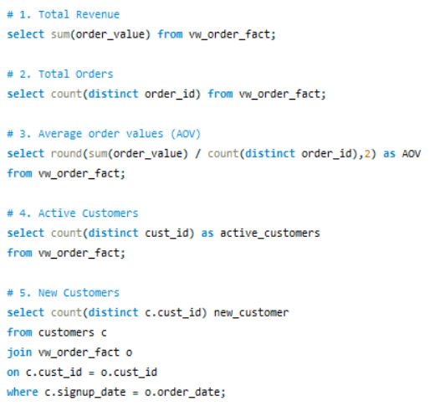
Core Business KPI – Total Revenue
Purpose
Measures overall platform performance and revenue scale.
Logic Applied
Aggregated total order value from fact table
Used pre-filtered analytical view for accuracy
Business Impact
Serves as the primary financial performance indicator
Used for growth tracking and executive reporting

Slide 8
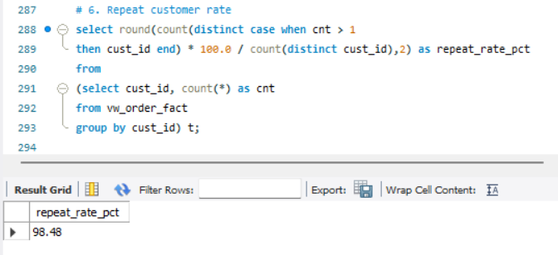
Customer Retention – Repeat Customer %
Purpose
Evaluates customer loyalty and platform stickiness.
Logic Applied
Counted orders per customer using aggregation
Used CTE to calculate repeat behavior
Converted results into percentage metric
Business Impact
High repeat rate indicates strong retention
Helps assess long-term revenue sustainability
Supports customer lifecycle strategy

Slide 9
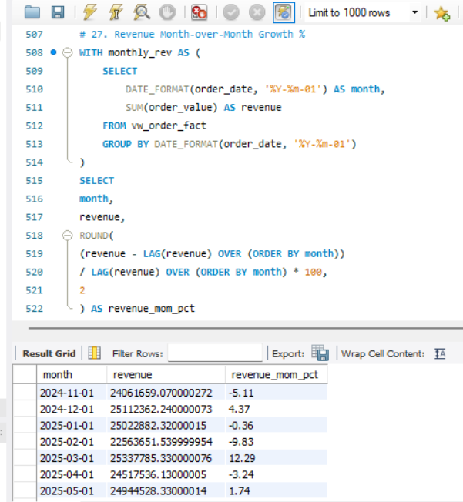
Revenue Growth – Month-over-Month %
Purpose
Tracks revenue momentum and growth trend over time.
Logic Applied
Aggregated monthly revenue
Used LAG() window function for previous month comparison
Calculated percentage growth
Business Impact
Identifies acceleration or slowdown
Supports forecasting and planning
Detects seasonality patterns

Slide 10
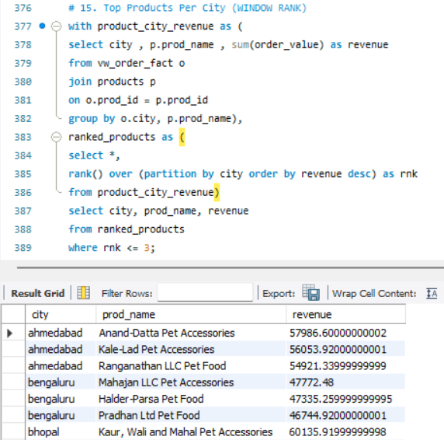
Top Products per City (Ranked)
Purpose
Identifies region-specific product demand patterns.
Logic Applied
Aggregated revenue by city and product
Used partitioned ranking with RANK()
Selected top 3 products per city
Business Impact
Enables localized marketing strategies
Supports regional inventory planning
Improves demand forecasting accuracy

Slide 11
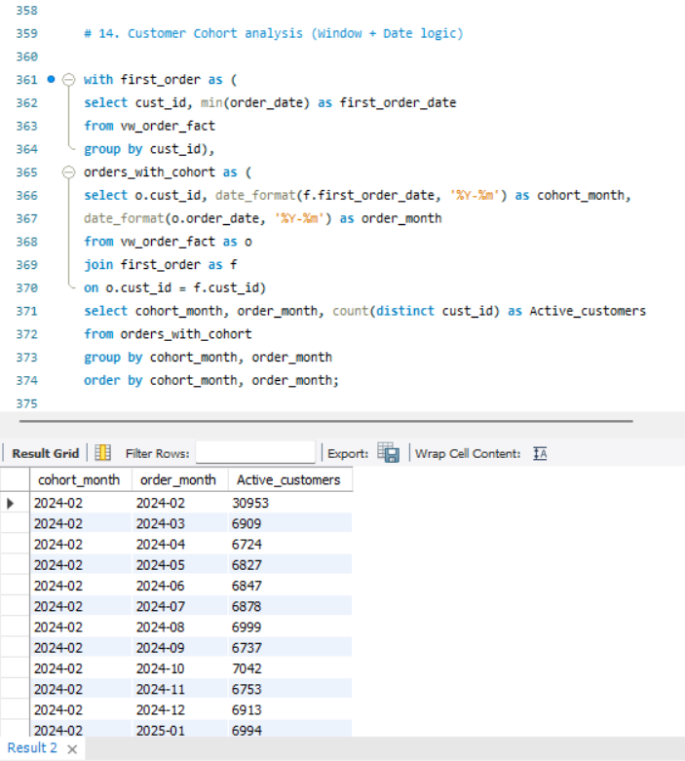
Customer Cohort Analysis
Purpose
Analyzes customer retention across different acquisition months.
Logic Applied
Identified each customer’s first purchase date
Grouped customers by cohort month
Tracked repeat activity over time
Business Impact
Measures retention decay
Evaluates marketing effectiveness
Helps optimize acquisition strategies

Slide 12
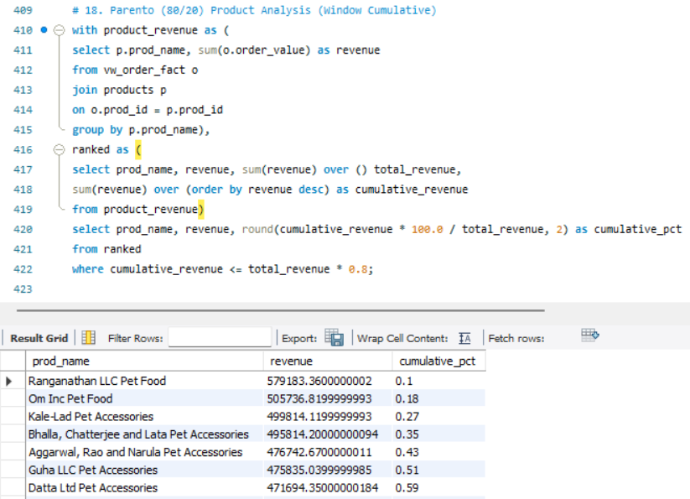
Pareto Analysis (80/20 Rule)
Purpose
Identifies products driving majority of revenue.
Logic Applied
Calculated product-wise revenue
Applied cumulative window function
Identified top contributors up to 80% revenue
Business Impact
Reveals revenue concentration risk
Helps prioritize inventory and marketing
Supports strategic product focus

Slide 13

Data Architecture
Python-Based Data Synthesis
Leveraging Python for the generation of synthetic datasets and execution of Extract, Transform, Load (ETL) scripts.
Power BI Analytics Dashboard
Comprehensive Data Flow to Power BI
Intermediate CSV Storage
Development of interactive dashboards within Power BI for comprehensive data visualization and metric reporting.
Utilizing flat-file comma-separated values (CSV) for interim data staging and transfer processes.
SQL-Based Semantic Layer Views
MySQL Relational Database
Construction of Structured Query Language (SQL) views to form a coherent semantic layer, enabling data integration and refinement.
Establishing persistent storage within a MySQL relational database management system for structured data entities.
Fundamental Database Entities
Customers
Products
Orders
Order Status Logs
Transactions
Date Dimension

Slide 14
Phase 1: Data Ingestion Protocol
Data Ingestion Methodologies
Database Structural Configuration
Facilitation of bulk data acquisition through `LOAD DATA INFILE`.
Standardization of boolean values to ensure consistency.
Systematic handling of null values leveraging the `NULLIF` function.
Strict enforcement of data type constraints for integrity.
Enabling `local_infile` for authorized local file data loading.
Utilizing the `InnoDB` storage engine for transaction support and referential integrity.
Implementation of indexing on pivotal columns to enhance query performance.
The successful execution of these strategies culminated in the establishment of a robust and scalable analytical database.

Slide 15
Phase 2 : Data Cleansing and Preparation Protocol
Data Rectification Protocols
Computational Frameworks Utilized
Normalization of geographical identifiers (e.g., city names)
Imputation or rectification of anomalous temporal entries
Verification of temporal data consistency and validity
Standardization of binary categorical attributes
Elimination of discordant or contradictory data entries
Pandas Library (for pre-database manipulation and transformation)
Structured Query Language (for database-level integrity enforcement and validation)
Resultantly, this phase facilitates the establishment of robust Key Performance Indicators (KPIs) and ensures the consistency and credibility of subsequent analytical reporting.

Slide 16
Phase 3: Establishment of the SQL-Based Analytical Layer
Development of Analytical Views
Application of Advanced SQL Constructs
vw_order_fact
vw_order_lifecycle
vw_payment_fact
Common Table Expressions (CTEs)
Window functions
Cohort analysis
Rank and cumulative analysis
Service Level Agreement (SLA) and percentile calculations
This SQL-driven architecture concurrently serves as the definitive Single Source of Truth.

Slide 17

Exploration of Power BI Dashboard: Design Principles and Analytical Outcomes

Slide 18
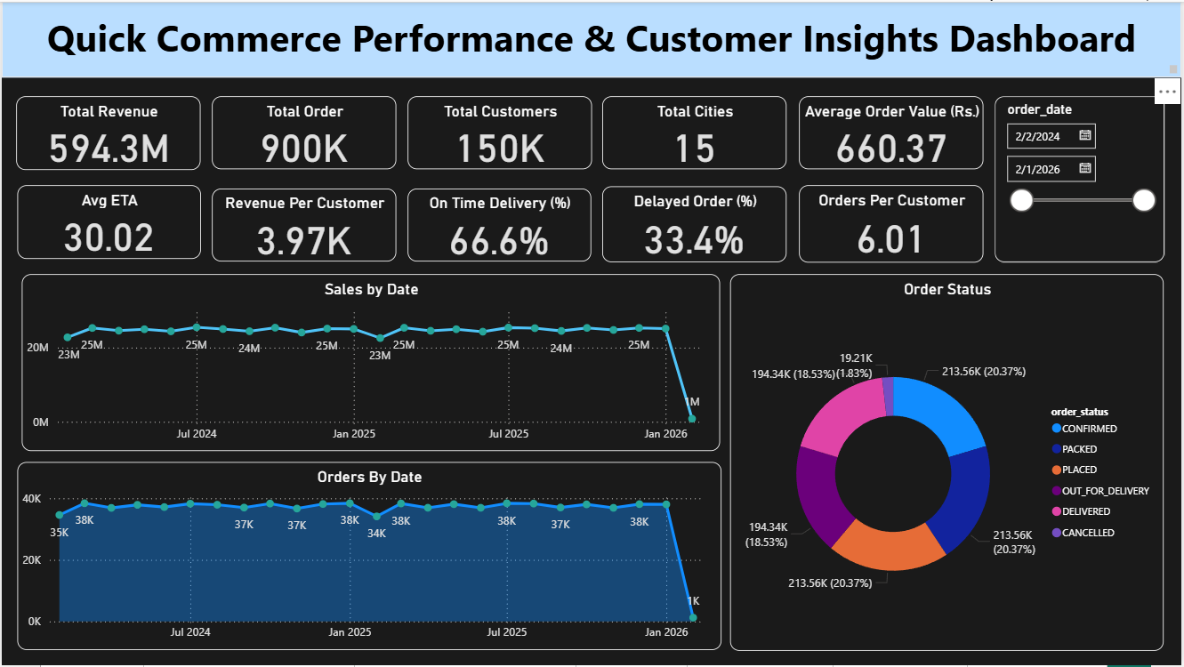
REPORT 1 – SUMMARY DASHBOARD
Key Performance Indicators (KPIs) Displayed
Total Revenue: 594.3M
Total Orders: 900K
Total Customers: 150K
Average Order Value: 660
On-Time Delivery: 66.6%
Delayed Orders: 33.4%
Key Insights
Strong revenue volume with high order frequency
Delivery delays impact one-third of orders
Healthy customer base across 15 cities

Slide 19
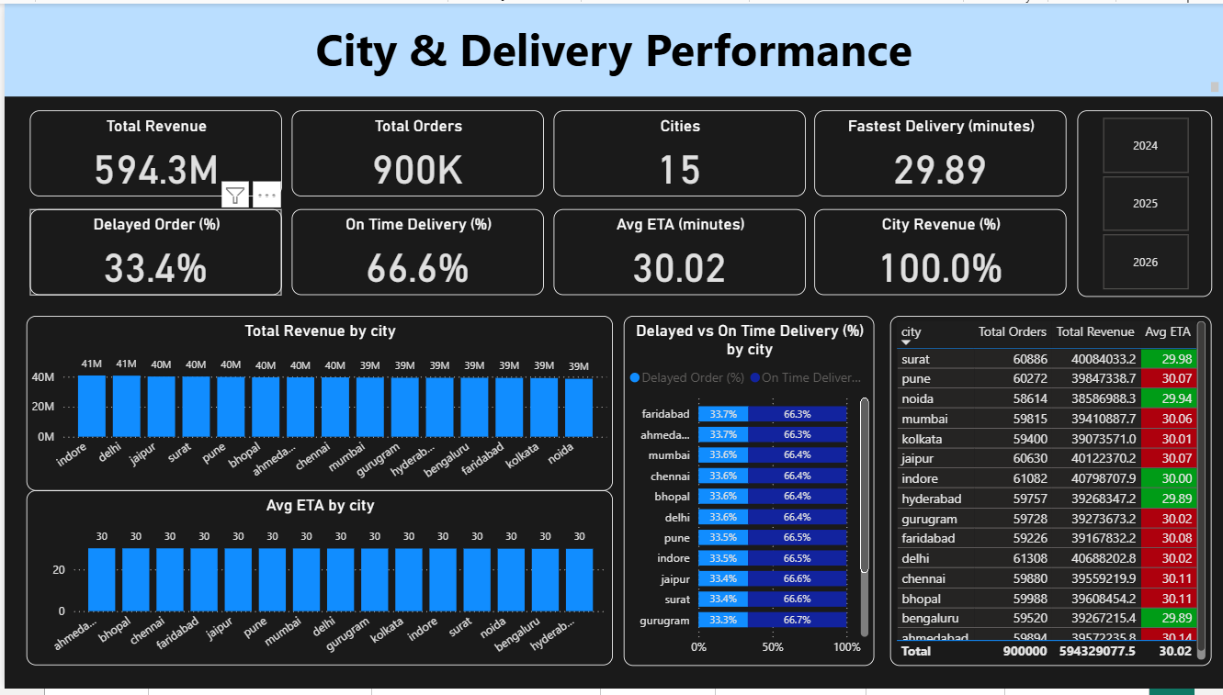
REPORT 2 – CITY & DELIVERY PERFORMANCE
Key Performance Indicators (KPIs)
Revenue & Orders by City
Average ETA by City
On-Time vs Delayed Delivery
Fastest & Slowest Cities
Key Insights
Revenue is evenly distributed across major cities
Avg ETA ≈ 30 minutes across locations
Delivery performance is consistent but optimization is possible

Slide 20
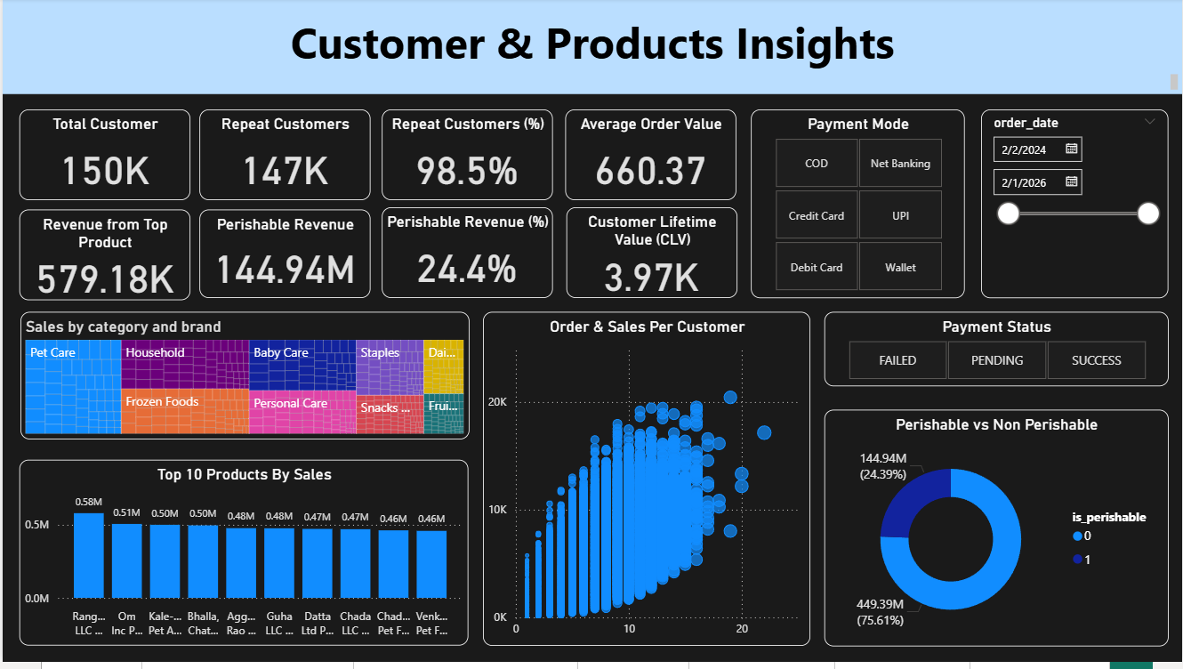
REPORT 3 – CUSTOMER & PRODUCTS INSIGHTS
Customer KPIs
Repeat Customers: 98.5%
Orders per Customer: 6+
Customer Lifetime Value: ₹3.97K
Product KPIs
Top products drive majority of revenue
Perishable revenue contributes ~24%
Product-category mix impacts revenue stability
Insights
Strong customer retention
Revenue concentration among top products

Slide 21
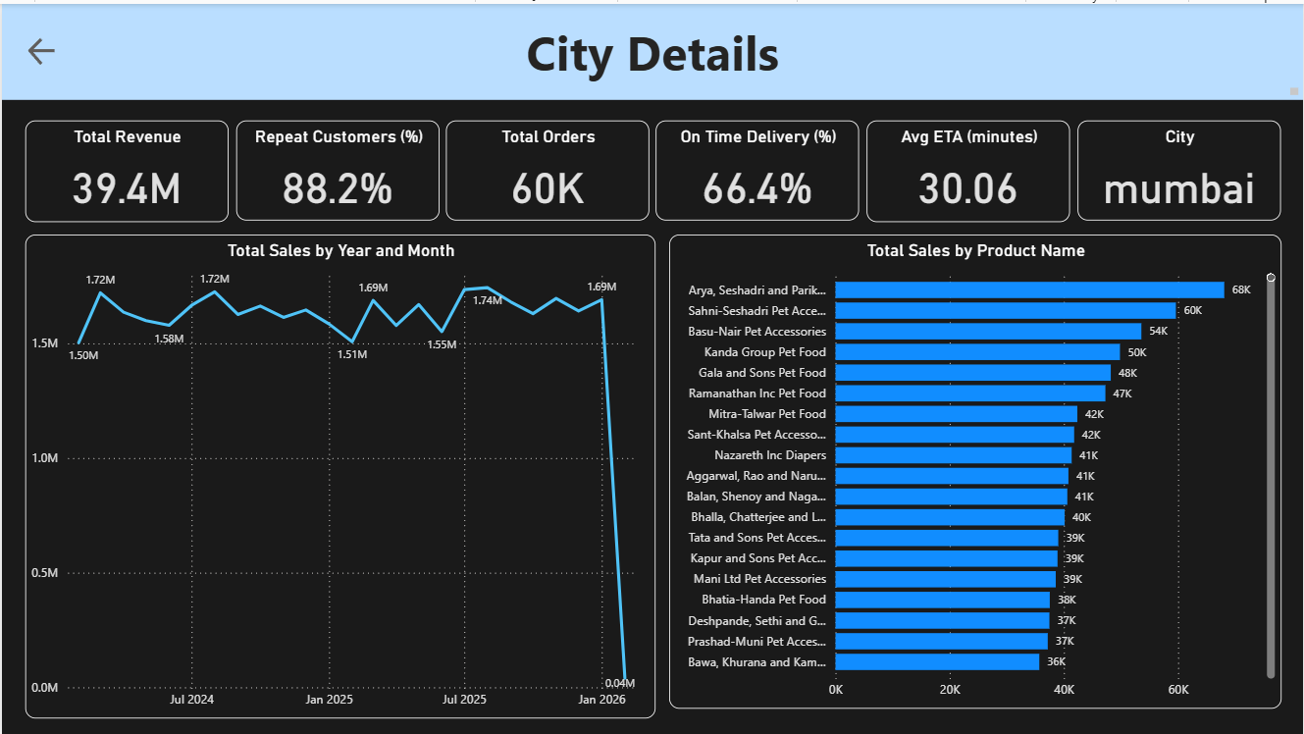
REPORT 4 – CITY DETAILS (DRILL-THROUGH)
Metrics
City-level Revenue & Orders
Avg ETA per City
Product contribution within city
Insights
Allows city-specific performance analysis
Helps identify local operational bottlenecks
Useful for regional planning & expansion

Slide 22
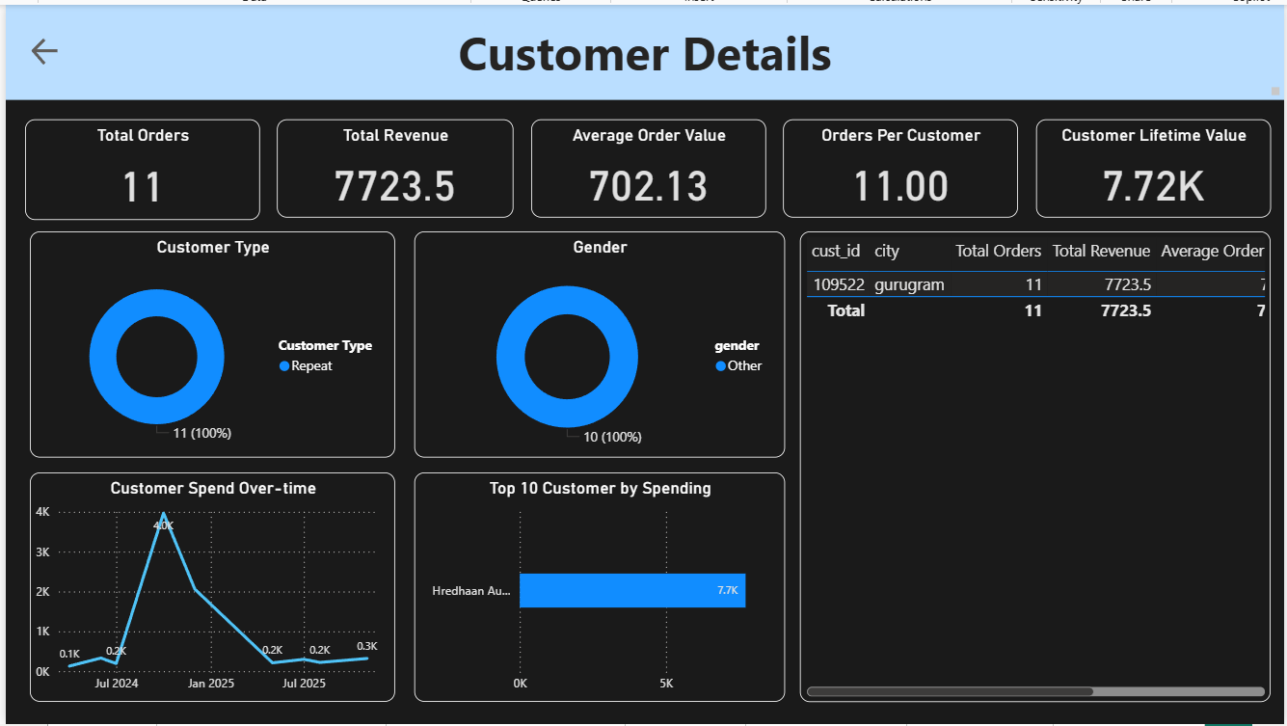
REPORT 5 – CUSTOMER DETAILS (DRILL-THROUGH)
Metrics
Orders per Customer
Customer Lifetime Value
Spend Over Time
Top Customers by Revenue
Insights
Identifies high-value customers
Enables targeted loyalty strategies
Supports customer segmentation

Slide 23
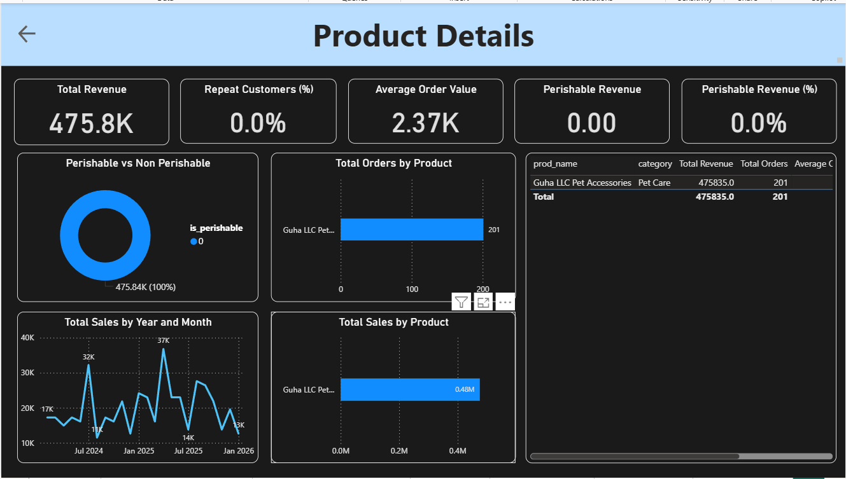
REPORT 6 – PRODUCT DETAILS (DRILL-THROUGH)
Metrics
Product Revenue & Orders
Perishable vs Non-Perishable
Product Sales Trend
Insights
Helps optimize pricing & inventory
Identifies high-margin products
Tracks product lifecycle performance

Slide 24
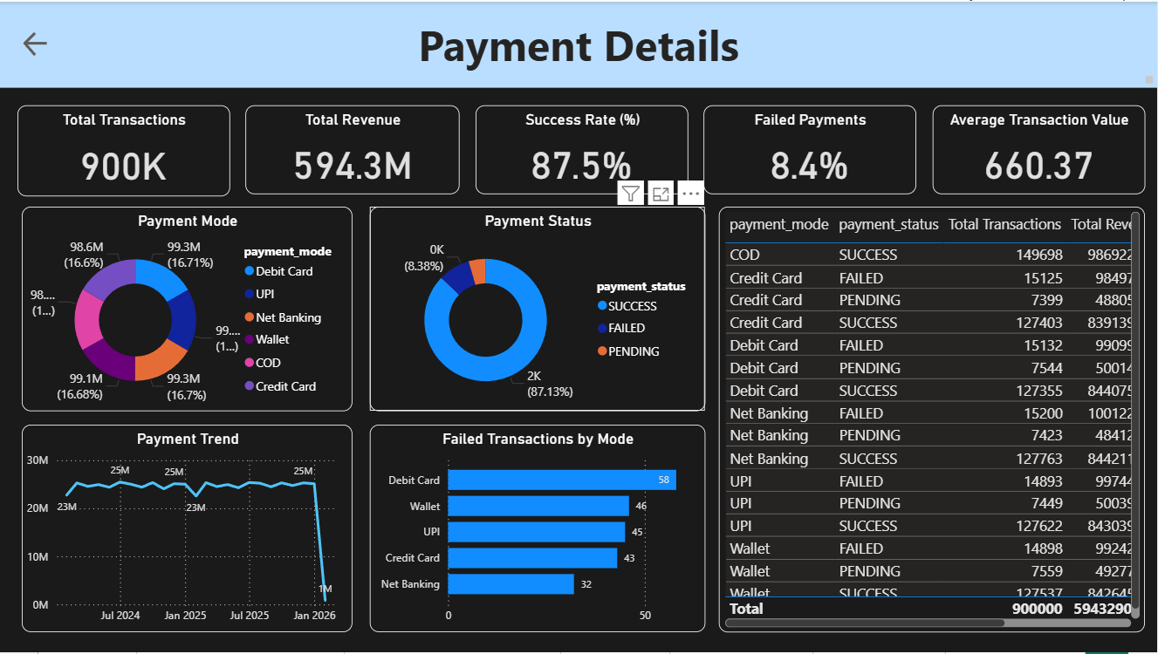
REPORT 7 – PAYMENT DETAILS
Metrics
Success Rate: 87.5%
Failed Payments: 8.4%
Payment Modes Distribution
Failure Trend by Mode
Insights
Payment failures directly impact revenue
UPI & Wallet show higher transaction volume
Monitoring failures improves conversion

Slide 25
KEY INSIGHTS
Revenue is driven by high order frequency & repeat customers
Delivery delays affect customer experience
Revenue concentration in top products & cities
Payment failures are a measurable revenue leakage
Drill-through enables deep operational visibility

Slide 26
FUTURE WORK
01
02
03
Sales & demand forecasting
Customer segmentation (RFM)
Profit margin analysis
04
05
Real-time dashboard integration
Automation using Python pipelines

Slide 27

RESOURCES
Tools
References
Python (Pandas)
MySQL
Power BI
Excel
SQL & Power BI Documentation
Data Analytics Best Practices

